Slide 1
LPC2148-PLL (Phase Locked Loop)

Slide 2
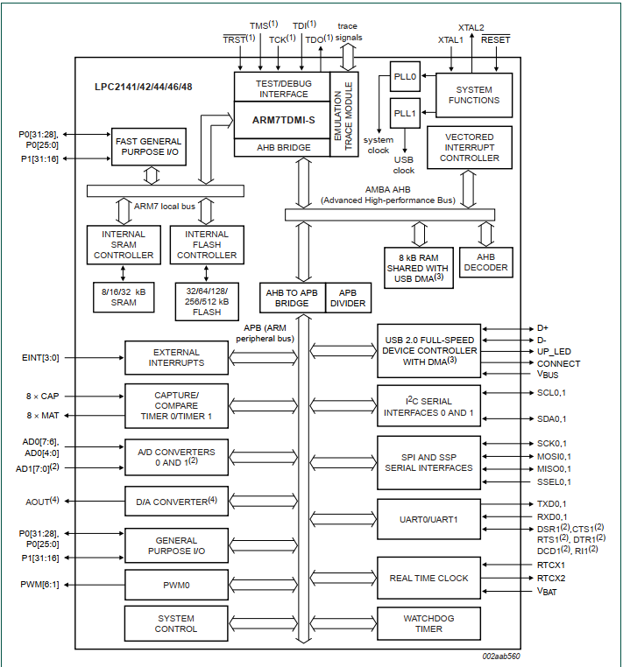
LPC2148 ARCHITECTURE

Slide 3
PLL- Phase Locked Loop
An indispensable component in modern electronic systems
Function is to generate an accurate output signal of frequency equal to, or a multiple of, the input signal frequency.
Mainly used in
Modulators/Demodulators
Clock generation and multiplication.

Slide 4
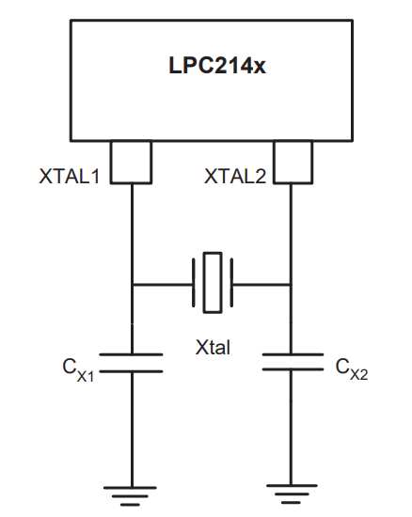
Crystal Oscillator
12MHz Crystal
Using internal PLL in LPC2148, generating a 60MHz clock signal
On that clock, we are operating CPU and all peripherals
LPC2148
12MHz Crystal Oscillator
PLL
60MHz clock

Slide 5
Clock Options of LPC2148
XTAL1 →Can provide direct clock (1MHz to 50MHz)
XTAL1-XTAL2 →External Crystal (1MHz to 30MHz)
On chip PLL with External Crystal →External Crystal (10MHz to 25MHz) 60 MHz

Slide 6
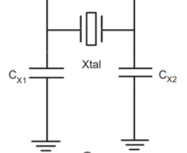
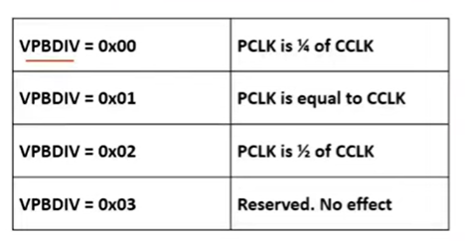
Clock in LPC2148
Oscillator
PLL
CCLK
60 MHz
CPU
12MHz
CCLK
60 MHz
VPB DIV
PCLK
15 MHz
Peripherals

Slide 7
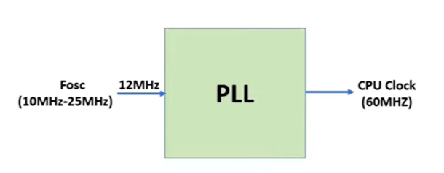
PLLs in LPC2148
2 PLL
PLL0 and PLL1
PLL0 --- For CCLK and PCLK
PLL1 --- For USB Clock (48MHz)
PLL input clock range between 10MHz to 25MHz
This input clock is multiplied and scaled accordingly
Maximum CPU frequency is 60 MHz

Slide 8
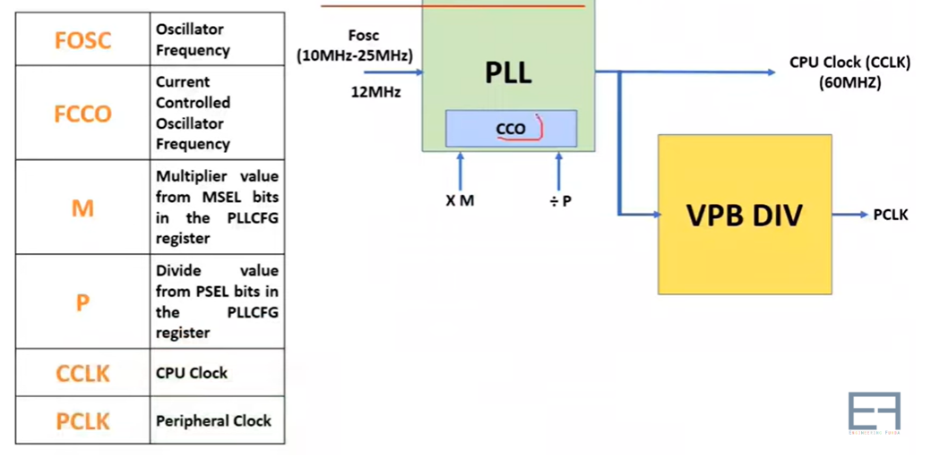
PLL Architecture
CCO → 156MHz to 320MHz

Slide 9
PLL Output Clock Formula
CCO → 156MHz to 320MHz

Slide 10
Special Function registers (SFR) in PLL
PLL0FEED → Feed Sequence SFR
PLL0CON → PLL Control Register
PLL0CFG → PLL Configure Register
PLLSTAT → PLL Status Register
VPBDIV → VLSI Peripheral Bus Divider

Slide 11
PLL0Feed Register
A correct feed sequence must be written to the PLLFEED register in order for changes to the PLLCON and PLLCFG registers to take effect
PLL0FEED = 0XAA
PLL0FEED = 0X55

Slide 12
PLL0CON Register
- - - - - - - - - - - -
PLLC
PLLE
31
1
0
PLLE = 1 ; will make PLL enable
PLLC = 1 ; will connect PLL with CPU otherwise CPU will take clock directly from Oscillator
PLL0CON = 0X01; //PLL Enable
PLL0CON = 0X03; //PLL Enable & Connect

Slide 13
PLL0CFG Register
- - - - - - - - - - - -
PSEL1
PSEL0
MSEL4
MSEL3
MSEL2
MSEL1
MSEL0
31
6
5
4
3
2
1
0
MSEL[4:0] Multiplier Bits Supply the value M in PLL frequency calculation
PSEL[1:0] Divider Bits Supply the value P in PLL frequency calculation

Slide 14
MSEL Bit Calculation

Slide 15
PSEL Calculation
P = FCCO / (2 x CCLK)
FCCO range is 156MHz to 320MHz, here CCLK = 60MHz
For, FCCO = 156MHz, we get P = 1.3
For, FCCO = 320MHz, we get P = 2.67
So, we have to take integer value for P between 1.3 and 2.67 that will ensure FCCO will work in 156MHz-320MHz
So, we will take integer value P=2
PLL0CFG = 01 00100
PLL0CFG =0X24
P | PSEL bit [5:6]
1 | 00
2 | 01
4 | 10
8 | 11

Slide 16
PLL0STAT register
PLL is ready or not
This register is read only
This register is used to read PLL status
We observe 10th bit of PLL0STAT which is PLOCK
If PLOCK = 1, it indicate PLL is now locked to the target frequency

Slide 17
PLL Setup Steps
Initialize PLL
Apply Feed Sequence
Wait for PLL to lock and then connect PLL
Apply Feed Sequence

Slide 18
Embedded C program for setting PLL to 60MHz
void set_pll()
{
PLL0CON=0X01 //PPLE=1&PPLC=0 so it will be enabled but not connected
PLL0CFG=0X24 //Set up PLL for CCLK=60MHz
PLL0FEED=0XAA //feed sequence
PLL0FEED=0X55
while((PLL0STAT&(1<<10))==0); //check whether PLL has locked on to the desired frequency
PLL0CON=0X03 //enalble & connect PLL
PLL0FEED=0XAA
PLL0FEED=0X55
VPBDIV=0X01 //PCLK is same as CCLK, ie 60MHz
}

Slide 19
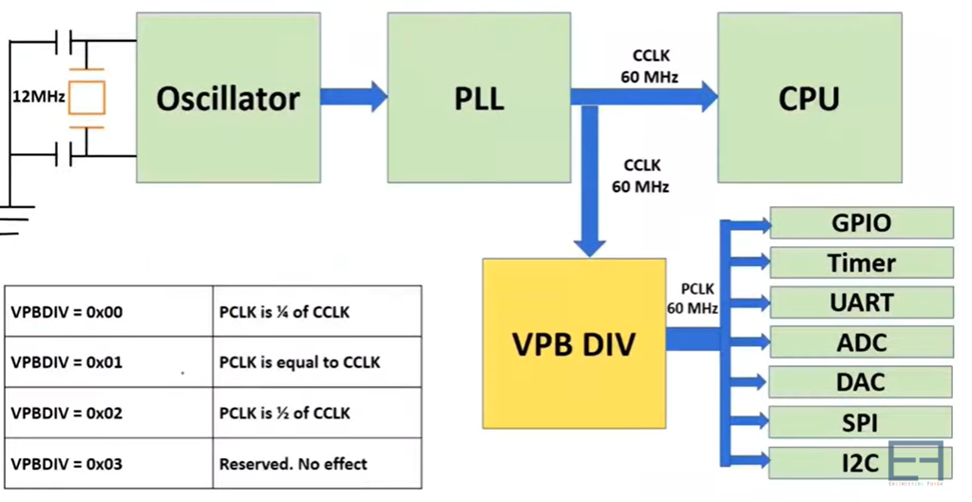

Slide 20
Refernce
LPC 2148 PLL Phase Lock Loop & C Program - YouTube

